Slide 1
May 2024
Public

Slide 2
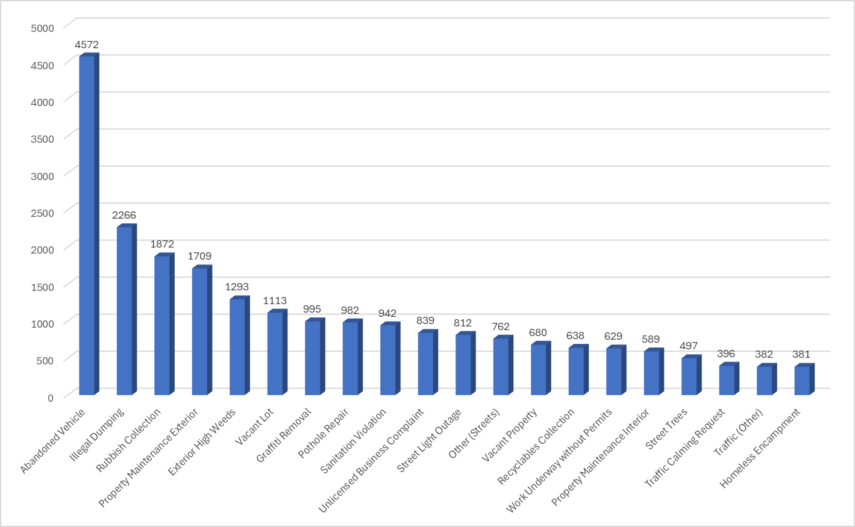
Top 20 Service Requests of the 27,752 Total Cases Submitted

Slide 3
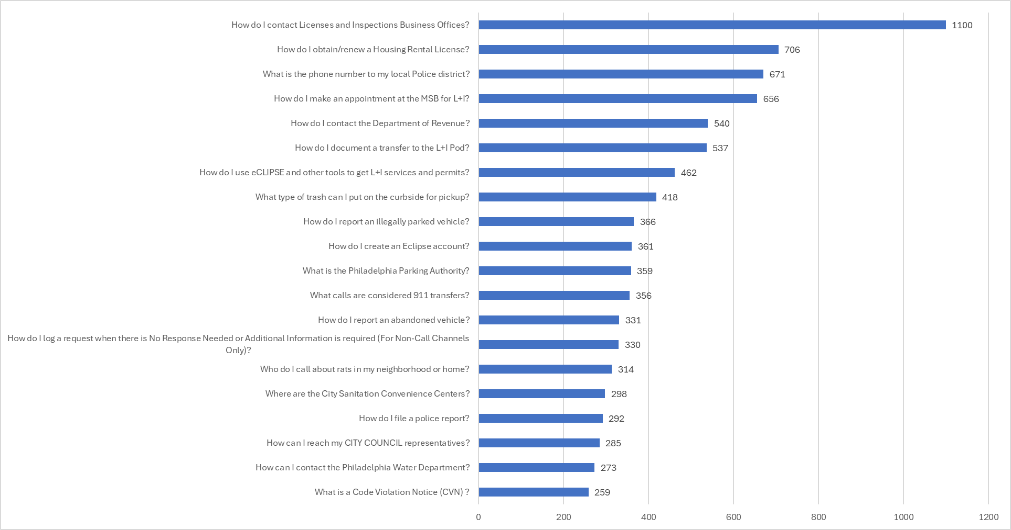
Top 20 Information Requests of the 25,941 Total Cases Submitted

Slide 4
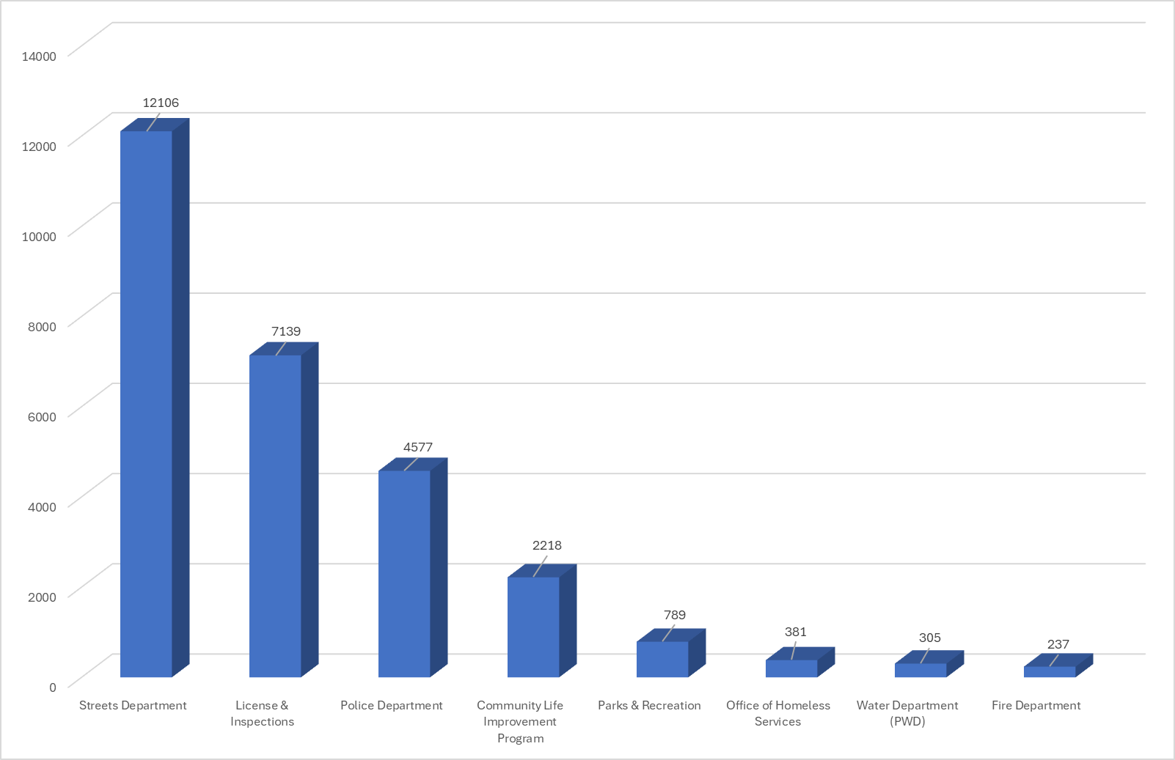
Service Requests by Department of the 27,752 Total Cases Submitted

Slide 5
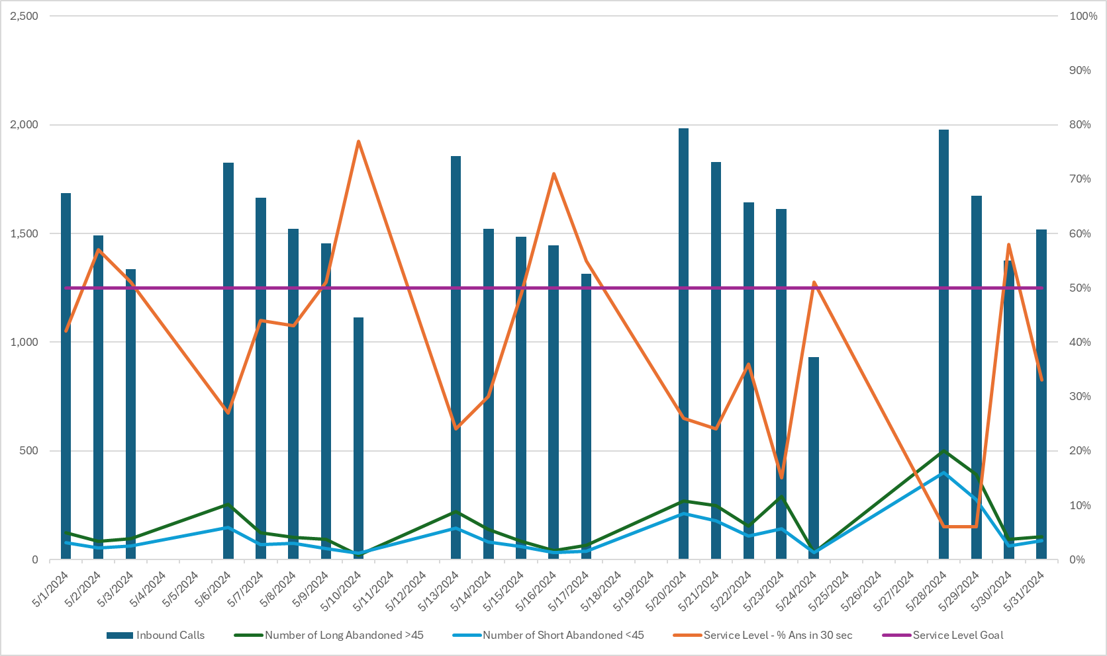
Philly311 Call Volumes, Abandons and Service Level by Day
May 2024 | Week 1 (5/1-5/4) | Week 2 (5/5-5/11) | Week 3 (5/12-5/18) | Week 4 (5/19-5/25) | Week 5 (5/26-5/31)
Calls Handled | 4,513 | 7,577 | 7,619 | 7,997 | 6,542
Service Level (Goal 50%) | 50% | 48% | 46% | 30% | 26%
Average Speed of Answer (Goal <30s) | 5:04 | 5:02 | 4:59 | 5:01 | 4:52
Average Talk Time | 4:40 | 4:36 | 4:34 | 4:35 | 4:27
“Service Level” is the percentage of calls answered in less than 30 seconds. Our goal is 50%.
“Average Speed of Answer” is the average wait time the call experiences in queue.

